Slide 1
Lecture 6: Nested if and Multi-way if-else statements, Logical Operators, Operator Precedence
Reading: Chapter 3, 3.5 - 3.6, 3.8 - 3.12, 3.15

Slide 2
Review of last lecture
boolean data type: Can only be true or false.
boolean expressions: Evaluate to true or false.
One-way if statements:
Two-way if-else statements:
if (boolean-expression)
{
// Do really cool stuff inside the if-block
}
if (boolean-expression)
{
// Do really cool stuff if it’s true
}
else
{
// Do different cool stuff if it’s false
}

Slide 3


Nested if statements
An if statement or if-else statement can be placed inside another if statement to form a nested if statement.
By convention, the “inside” if statement is indented to indicate that it’s inside the first one.
Why do this? Sometimes, you only want to do something if more than one condition is true.

Slide 4
Example
NOTE: S.O.P.L is an abbreviation for System.out.println. It is NOT actual Java code!!
public static void main(String[] args)
{
int x = 4; int y = -2;
if (x > 0)
{
if (y > 0)
{
S.O.P.L(“Both x and y are positive.”);
}
else
{
S.O.P.L(“x and y have different signs.”);
}
}
}
This whole if-else block is indented because it is inside the first if-statement.
This whole if-else block
ONLY gets executed if
x > 0 evaluates to true.

Slide 5
What is the output in this example?
public static void main(String[] args)
{
int x = -4; int y = -2;
if (x > 0)
{
if (y > 0)
{
S.O.P.L(“Both x and y are positive.”);
}
else
{
S.O.P.L(“x and y have different signs.”);
}
}
}
NOTHING!

Slide 6

Remember the rule about only having one line after an if when you don’t use braces?
This WILL compile! And it WILL be correct!
public static void main(String[] args)
{
int x = 4; int y = -2;
if (x > 0)
if (y > 0)
{
S.O.P.L(“Both x and y are positive.”);
}
else
{
S.O.P.L(“x and y have different signs.”);
}
}
Java views if statements and if-else statements as being one line because they are blocks.

Slide 7
What about this?
This WILL compile! But it will give you the WRONG output!
public static void main(String[] args)
{
int x = -4; int y = -2;
if (x > 0)
S.O.P.L(“Inside the if!”);
if (y > 0)
{
S.O.P.L(“Both x and y are positive.”);
}
else
{
S.O.P.L(“x and y have different signs.”);
}
}
It associates the print statement with the if, but not the if-else block.
Output Window
x and y have different signs.

Slide 8
What about this?
This WILL compile! But it will give you the WRONG output!
public static void main(String[] args)
{
int x = -4; int y = -2;
if (x > 0)
if (y > 0)
{
S.O.P.L(“Both x and y are positive.”);
}
else
{
S.O.P.L(“x and y have different signs.”);
}
S.O.P.L(“Inside the if!”);
}
It associates the if-else block with the if, but not the print statement.
Output Window
Inside the if!

Slide 9
What about this?
This WILL compile! And it will give you the correct output!
public static void main(String[] args)
{
int x = 4; int y = -2;
if (x > 0)
if (y > 0)
S.O.P.L(“Both x and y are positive.”);
else
S.O.P.L(“x and y have different signs.”);
}
The if-else is following the one line rule and because the if-else block is like one line to the Java compiler, then the first if is following the rule.
Remember: The Java compiler views an if block or an if-else block as one line. You just have to remember to follow the one line rule.
Output Window
x and y have different signs.

Slide 10
Multi-way if-else statements
What if you want to test multiple conditions? Case 1, case 2, case 3, ... and so on.
You can have as many else ifs as you want.
if (boolean-expression-1)
{
// Do stuff for case 1 }
else if (boolean-expression-2)
{
// Do stuff for case 2
}
.
.
.
else
{
// If nothing else works, do stuff here
}
Order matters! It starts with the first statement and checks to see if its true and then goes on to the next one and so on.
Once it finds one that is true it doesn’t check any of the others.

Slide 11
Example
Write code that will print out “A” if your score is greater than or equal to 90, “B” if your score is greater than or equal to 80 (but less than 90), and so on. Assume the variable score has already been created.
if (score >= 90)
S.O.P.L(“A”);
else if (score >= 80)
S.O.P.L(“B”);
else if (score >= 70)
S.O.P.L(“C”);
else if (score >= 60)
S.O.P.L(“D”);
else
S.O.P.L(“F”);
Checks this one first.
Then checks this one. We don’t have to check if it’s less than 90, because if we made it to this point, then the first case wasn’t true.
Then checks this one. We don’t have to check if it’s less than 90 or 80, because if we made it to this point, then the first two cases weren’t true.
Then checks this one. We don’t have to check if it’s less than 90, 80 or 70, because if we made it to this point, then the first two cases weren’t true.
If none of the above were true, then we do this.

Slide 12
Example
Write code that will print out “A” if your score is greater than or equal to 90, “B” if your score is greater than or equal to 80 (but less than 90), and so on. Assume the variable score has already been created.
if (score < 60)
S.O.P.L(“F”);
else if (score < 70)
S.O.P.L(“D”);
else if (score < 80)
S.O.P.L(“C”);
else if (score < 90)
S.O.P.L(“B”);
else
S.O.P.L(“A”);
Checks this one first.
Then checks this one. We don’t have to check if it’s less than 90, because if we made it to this point, then the first case wasn’t true.
Then checks this one. We don’t have to check if it’s less than 90 or 80, because if we made it to this point, then the first two cases weren’t true.
Then checks this one. We don’t have to check if it’s less than 90, 80 or 70, because if we made it to this point, then the first two cases weren’t true.
If none of the above were true, then we do this.

Slide 13
Quick Note
if (score >= 90)
{
S.O.P.L(“A”);
}
else if (score >= 80)
{
S.O.P.L(“B”);
}
else if (score >= 70)
{
S.O.P.L(“C”);
}
else if (score >= 60)
{
S.O.P.L(“D”);
}
else
{
S.O.P.L(“F”);
}
if (score >= 90)
S.O.P.L(“A”);
else if (score >= 80)
S.O.P.L(“B”);
else if (score >= 70)
S.O.P.L(“C”);
else if (score >= 60)
S.O.P.L(“D”);
else
S.O.P.L(“F”);
These are the same!
The one line rule applies here as well.

Slide 14
Common Errors
Adding a semi-colon at the end of an if line.
This is a logic error.
if (radius > 0);
{
area = radius * radius * 3.14;
S.O.P.L(“The area is: “ + area);
}
if (radius > 0){ }
{
area = radius * radius * 3.14;
S.O.P.L(“The area is: “ + area);
}
When you put a semi-colon at the end of an if line, it’s like you’re executing an empty block if the boolean expression for the if statement is true.

Slide 15

Common Errors
Redundant testing of boolean values.
When evaluating the boolean expression in the parentheses, you just need it to come out to be true or false. You don’t have to test it again to see if it’s true or false.
Redundant!
if (isEven == true)
S.O.P.L(“It’s even!”);
if (isEven)
S.O.P.L(“It’s even!”);

Slide 16
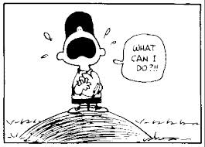
Common Errors
Equality testing of floating point numbers.
double x = 1.0 - 0.1 - 0.1 - 0.1 - 0.1 - 0.1;
S.O.P.L(x == 0.5);
In this case, x is not exactly 0.5. It is 0.5000000000000001. You cannot reliably test if two floating-point numbers are equal to each other because of round-off error.
final double EPSILON = 1E-14;
double x = 1.0 - 0.1 - 0.1 - 0.1 - 0.1 - 0.1;
if (Math.abs(x - 0.5) < EPSILON)
S.O.P.L(“x is approximately 0.5”);
Use the abs method in the
Math library to check if the two numbers are really close.

Slide 17
Common Errors
Dangling else ambiguity: In other words, which if does the else belong to when you don’t use braces??
int i = 1, j = 2, k = 3;
if (i > j)
if (i > k)
S.O.P.L(“A”);
else
S.O.P.L(“B”);
int i = 1, j = 2, k = 3;
if (i > j)
if (i > k)
S.O.P.L(“A”);
else
S.O.P.L(“B”);
If you don’t use braces, then the Java compiler matches up the else with the most recent if before it. So, either use braces, or be VERY careful with your indentation.

Slide 18

Common Pitfalls
Forgetting to simplify boolean variable assignments.
if ((number % 2) == 0)
isEven = true;
else
isEven = false;
boolean isEven = (number % 2) == 0
This is not an error, but why would you go through all that work to assign a boolean variable if the result of the boolean expression is true or false?!

Slide 19
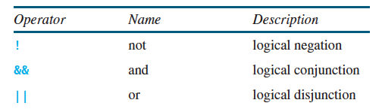
Logical Operators
The logical operators !, &&, and || can be used to create a compound boolean expression.
They are operators that are used to combine boolean expressions.

Slide 20

The not (!) operator
When the not operator is applied to a boolean expression, it changes the evaluation of the expression to be the opposite.
In other words: true gets changed to false and false gets changed to true.
Is age < 18? false
Then !(age < 18) is true.
Is age < 18? true
Then !(age < 18) is false.
int age = 24;
S.O.P.L(!(age < 18));
age = 16;
S.O.P.L(!(age < 18));

Slide 21
The and (&&) operator
For those of you who have taken (or are taking) CS-201, that’s the logical operator that looks like this: ∧
The boolean expression that uses the && operator is true only if whatever is on the left side of && is true AND whatever is on the right side of && is true.
int x;
boolean inRange;
x = 5;
inRange = (x > 0) && (x < 10);
x = -2;
inRange = (x > 0) && (x < 10);
x = 13;
inRange = (x > 0) && (x < 10);
Is 5 greater than 0? True.
Is 5 less than 10? True.
The whole expression evaluates to true.
Is -2 greater than 0? False.
Is -2 less than 10? True.
The whole expression evaluates to false.
Is 13 greater than 0? True.
Is 13 less than 10? False.
The whole expression evaluates to false.

Slide 22
The or (||) operator
For those of you who have taken (or are taking) CS-201, that’s the logical operator that looks like this: ∨
The boolean expression that uses the || operator is false when whatever is on the left side of || is false and whatever is on the right side of || is false.
int x;
boolean inRange;
x = 5;
inRange = (x < 0) || (x > 10);
x = -2;
inRange = (x < 0) && (x > 10);
x = 13;
inRange = (x < 0) && (x > 10);
Is 5 less than 0? False.
Is 5 greater than 10? False.
The whole expression evaluates to false.
Is -2 less than 0? True.
Is -2 greater than 10? False.
The whole expression evaluates to true.
Is 13 less than 0? False.
Is 13 greater than 10? True.
The whole expression evaluates to true.

Slide 23

And (&&) and Or (||) are opposites!
- Needs a true on each side to be true. - If either side is false, then the whole thing is false.
- Needs a false on each side to be false. - If either side is true, then the whole thing is true.

Slide 24
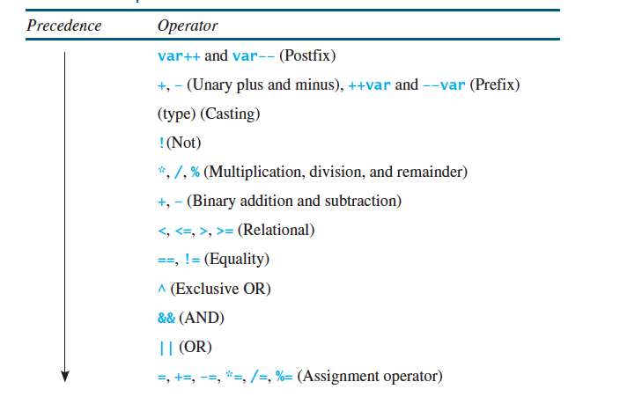
Operator Precedence
Things you do first
Things you do last

Slide 25
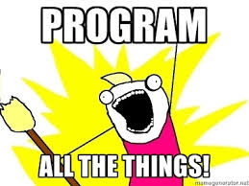
Let’s write a program together using all the things we learned today!
Write a program that asks the user to enter a number. If the number is divisible by 2 and 3, it should print out that it is divisible by both. If the number is divisible by 2 or 3, it should print out that it’s divisible by one or the other. If the number is not divisible by 2 or 3, then it should print that out.
Enter a number: 12
12 is divisible by 2 and 3
Enter a number: 15
15 is divisible by 2 or 3
Enter a number: 23
23 is not divisible by 2 or 3

Slide 26
import java.util.Scanner;
public class Divisible
{
public static void main(String[] args)
{
Scanner keyboard = new Scanner(System.in);
int num;
S.O.P(“Enter a number: ”);
num = keyboard.nextInt();
if ((num % 2 == 0) && (num % 3 == 0))
S.O.P.L(num + “ is divisible by 2 and 3”);
else if ((num % 2 == 0) && (num % 3 == 0))
S.O.P.L(num + “ is divisible by 2 or 3”);
else
S.O.P.L(num + “ is not divisible by 2 or 3”);
}
}

Slide 27

That’s all for today folks!
Read Chapter 3, Sections 3.5 - 3.6, 3.8 - 3.12, 3.15 A programming lab will be posted on Wednesday and is
due Monday, September 29th. You MUST work in groups
of 2 or 3.

